Slide 1
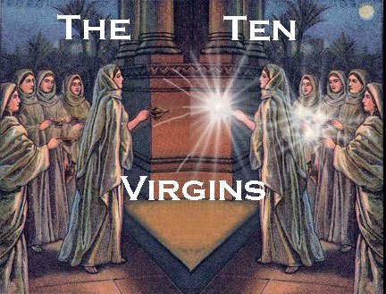
Five Were Wise – Five Were Foolish
Matthew 25:1-13

Slide 2
Preparation
For success
  Joshua.
  Joshua 1:10-11
  John. Isaiah 40:3
Unprepared: Shame, hurt, harm, danger.
2 Corinthians 9:3-4

Slide 3
Unprepared Spiritually
Parable of virgins.
Matthew 25:1-13
Preparation alone is not enough.
  Must do what we prepare to do.

Slide 4
When We Are Not Prepared For
The Lord’s Return We Are Being …
Foolish. Matthew 25:2; Ephesians 5:15-16
  Idle (lazy). Proverbs 6:6-11
  Spiritually lazy. Hebrews 6:9-12
Wasteful. Ephesians 5:16
(Matthew 25:8-12)
Self-centered and self-indulgent.
Luke 12:15-21
Unfaithful. Matthew 24:42-51

Slide 5
Must Prepare For …
Death.
Hebrews 9:27
(2 Kings 20:1)
  Obey gospel.
  Romans 6:16-18, 23
  Repent.
  2 Peter 3:9-10
  What hinders you?
  Acts 8:36

Slide 6
Must Prepare For …
Judgment.
Hebrews 9:27; Amos 4:12
  Avoid sin: Watch and pray. Luke 21:33-36
  Faithful living.
  Romans 2:3-11 (7, 10)
  Be Saved – Be Faithful
  – Be Growing

Slide 7
Must Prepare For …
Life. James 4:13-17
  In youth.
  Ecclesiastes 11:9-12:1
  In old age. Ecclesiastes 12:1ff
  Whole of our existence. Ecclesiastes 12:13-14

Slide 8
Preparation is Essential
Husband / Wife. Ephesians 5:22-33
Parent. Judges 13:8; Ephesians 6:4
  Sacrifice time, money, energy …
  Wisdom and self-discipline to train. Proverbs 4:1-4, 10-13, 20-23
  (Hebrews 12:6)

Slide 9
Preparation is Essential
Bible student and teacher.
2 Timothy 2:2, 15
  Accept the responsibility. James 3:1; Hebrews 5:12
  Equip yourself with the word.
  1 Timothy 4:13, 15-16
  Live the word. 1 Timothy 4:12
  Suffering. 2 Timothy 3:12; Hebrews 10:32ff

Slide 10
Preparation is Essential
Service in the kingdom of God. (Matthew 20:25-28)
  Teach sinners and saints.
  Matthew 28:18-20
    Both need teaching.
    Romans 10:13-15; 1:15
    Lost brethren.
    James 5:19-20 (Galatians 6:1)

Slide 11
Preparation is Essential
Service in the kingdom of God
(Matthew 10:42)
  Gospel preachers. 2 Timothy 4:2-5
  Elders and deacons. 1 Timothy 3:1, 10, 13
    Strive: “To stretch oneself, reach out after.”
    Faithful steward (3:13); 1 Peter 4:10-11

Slide 12
How tragic to miss heaven for being unprepared!
Matthew 25:11-12

